Slide 1
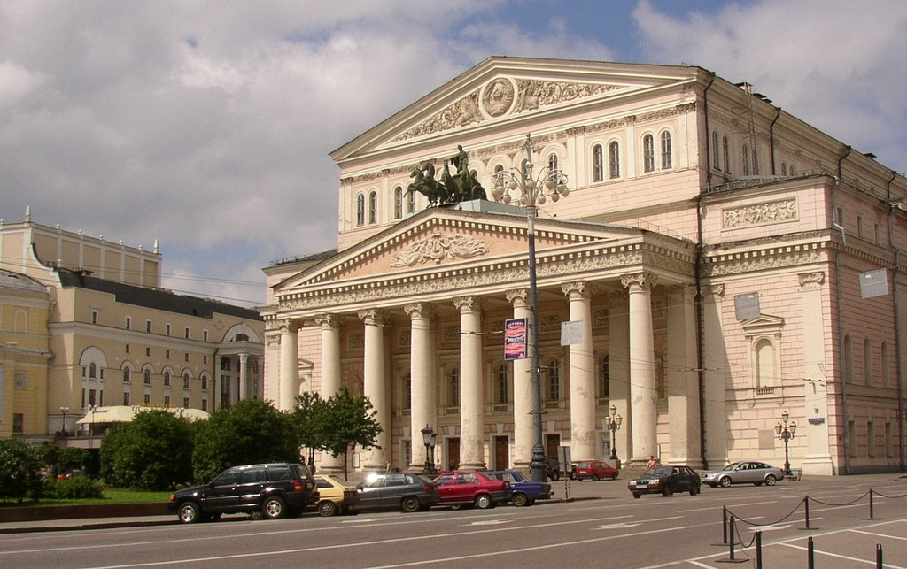
The Bolshoi Theatre

Slide 2
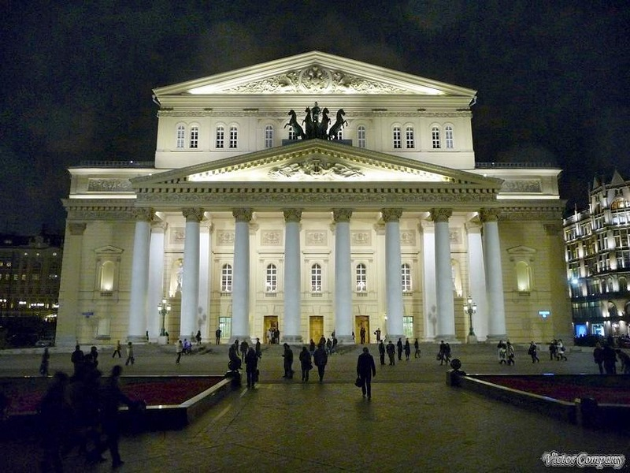
The Bolshoi Theatre is one of the oldest and biggest theatres in Russia. It is also one of the most renowned opera and ballet theatres in the world.

Slide 3
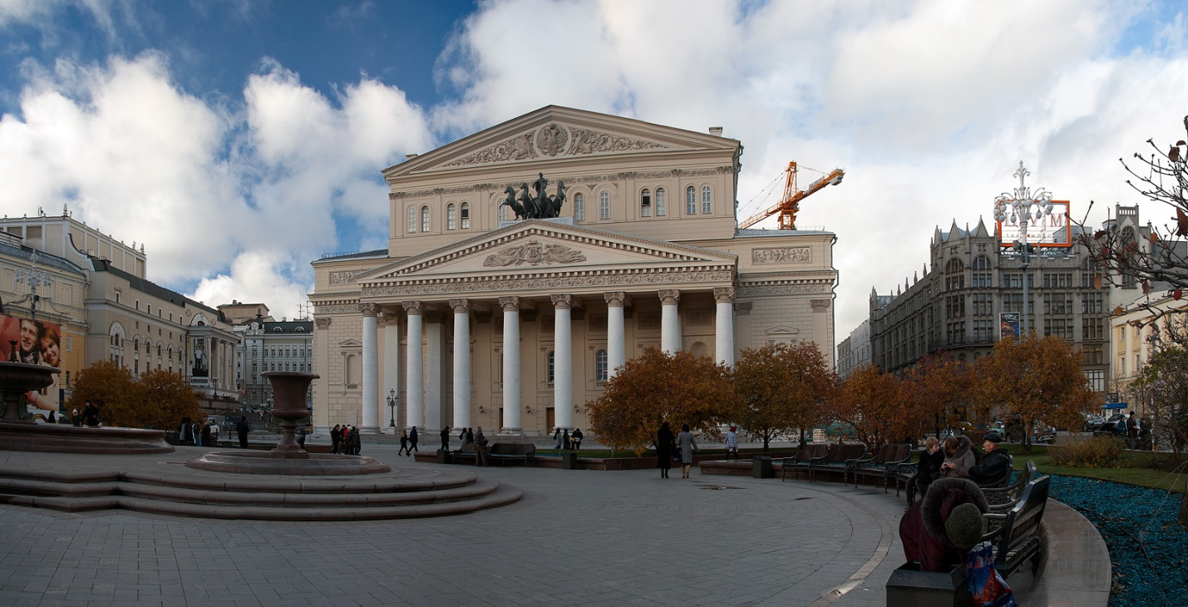
People sometimes call it shortly "The Bolshoi" and it is situated in the central part of Moscow. Originally it was an Imperial theatre.

Slide 4
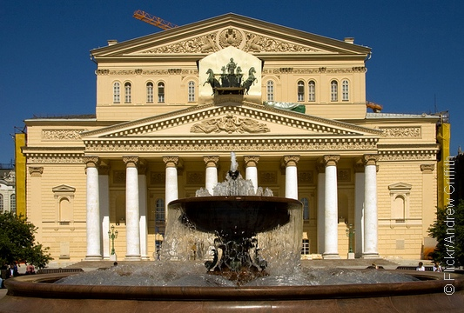
The architect who designed the building of The Bolshoi was Joseph Bove. It was built between 1821 and 1824. Since then, the building was renovated and rebuilt several times. However, it kept its original imperial decorations.

Slide 5
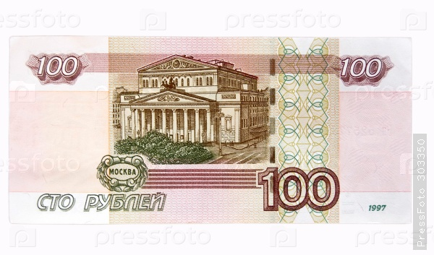
The neoclassical view of The Bolshoi can be seen on the Russian 100-ruble banknote.

Slide 6
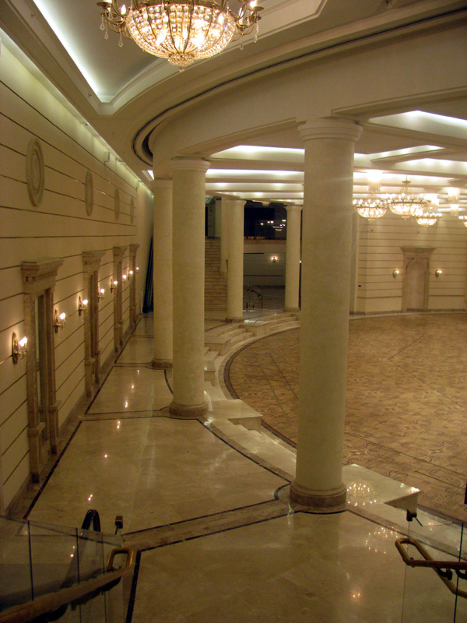
Today, it’s not simply the building of the theatre but it is also an outstanding landmark of Moscow.

Slide 7
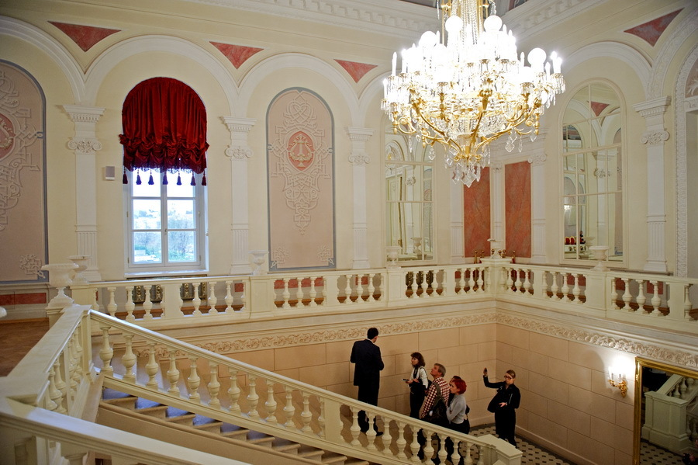

Slide 8
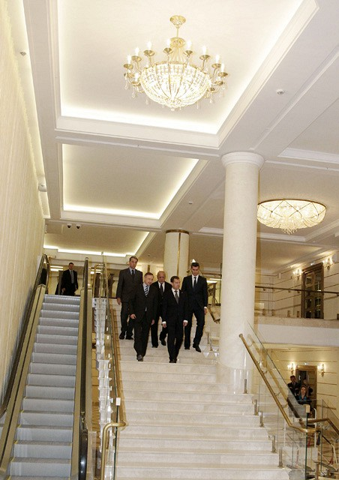

Slide 9
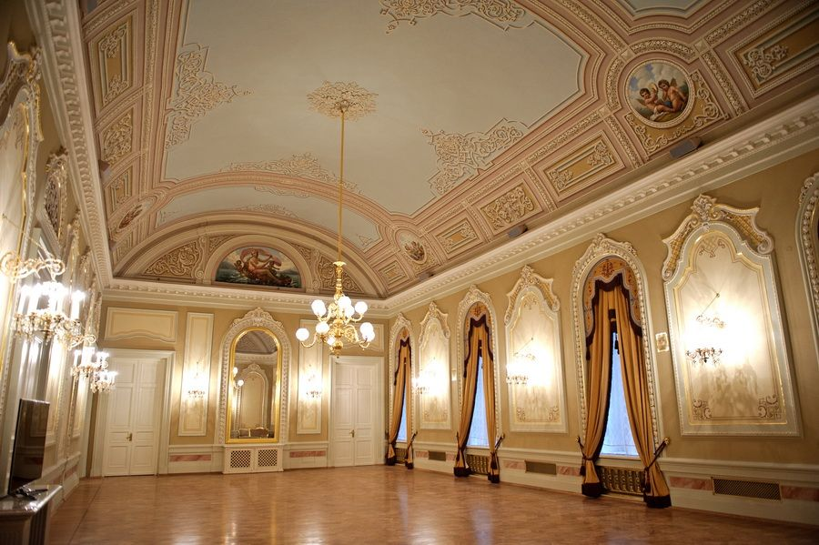

Slide 10
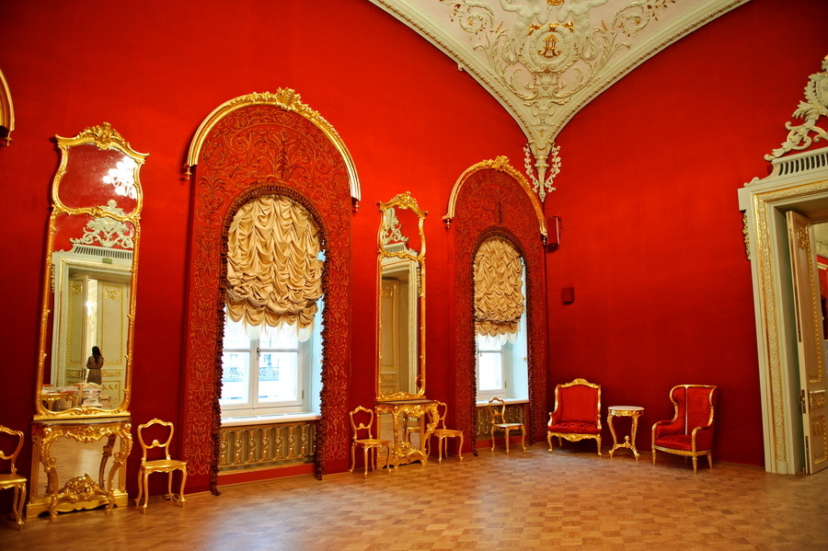

Slide 11
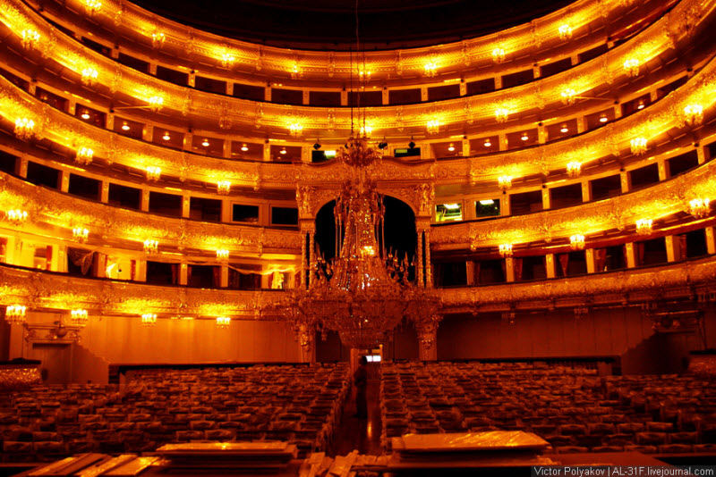

Slide 12
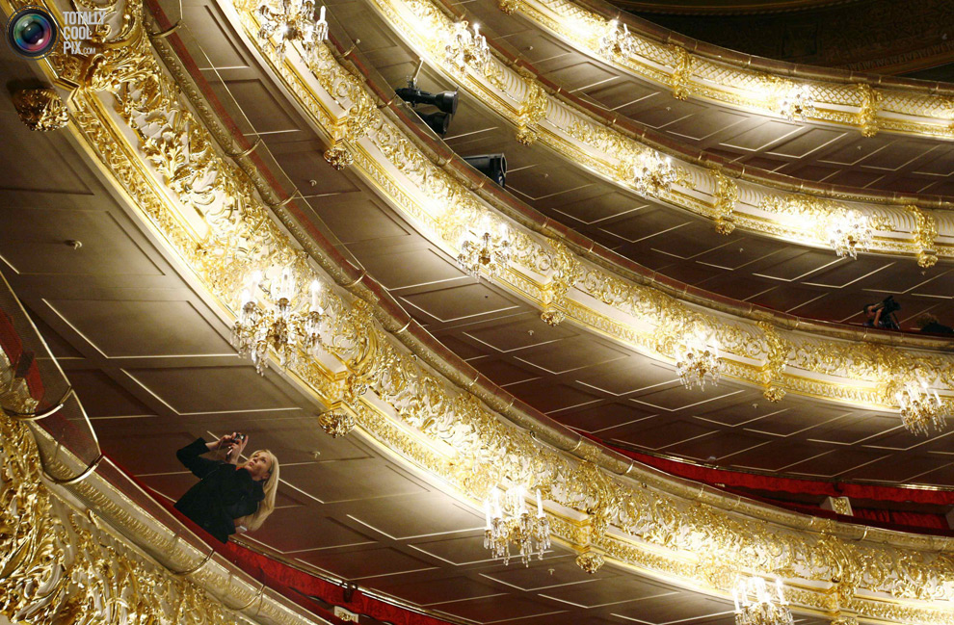

Slide 13
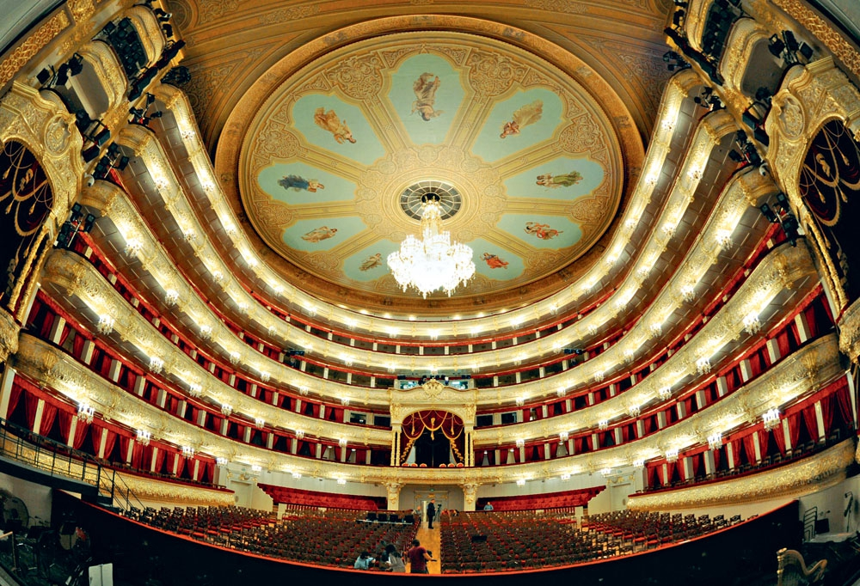

Slide 14
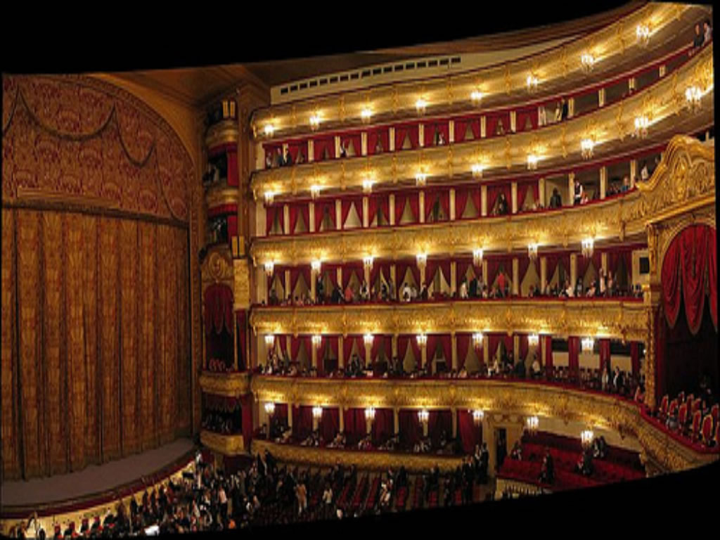

Slide 15
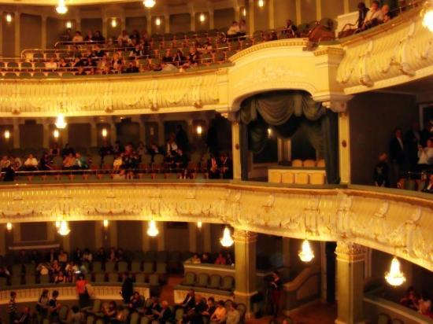

Slide 16
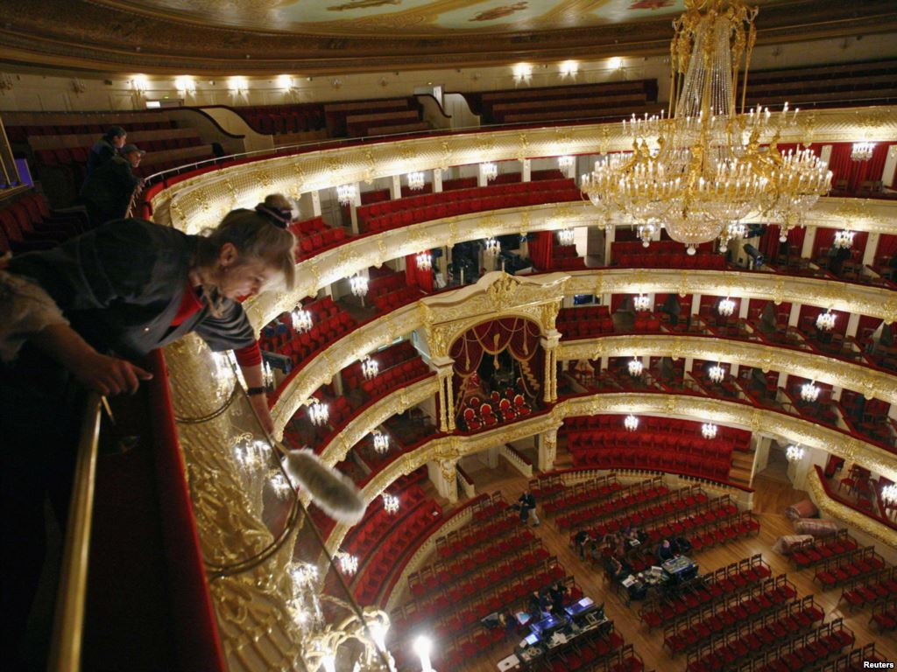

Slide 17
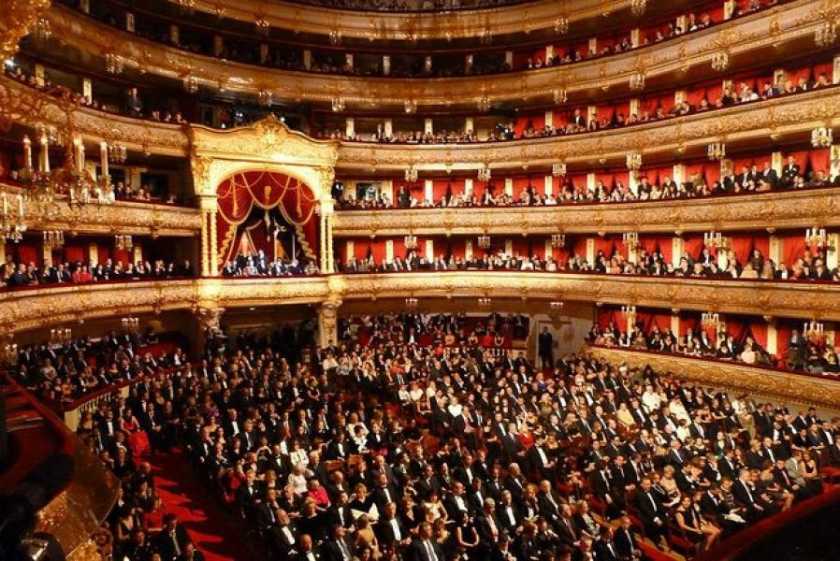

Slide 18
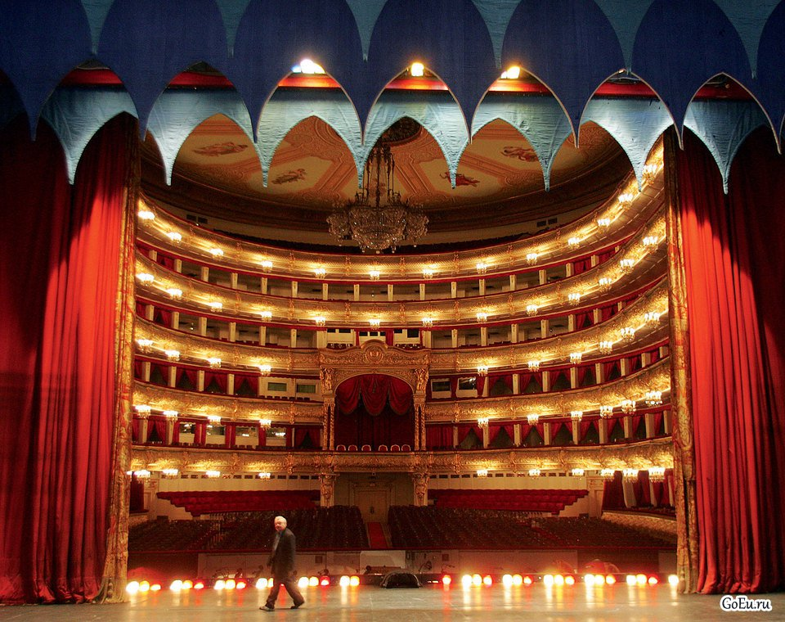

Slide 19
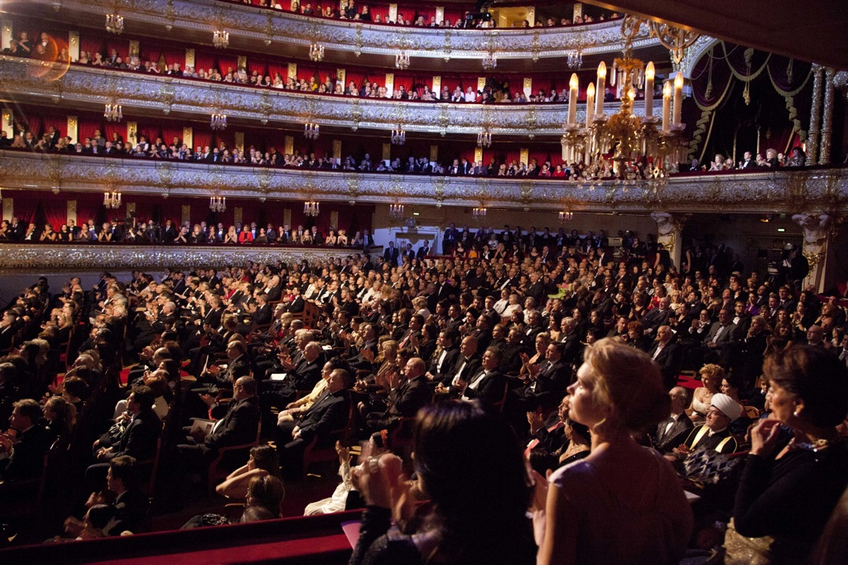
People like to go to the theatres to see interesting performances, to enjoy beautiful architecture. A theatrical performance is always a mystery.

Slide 20
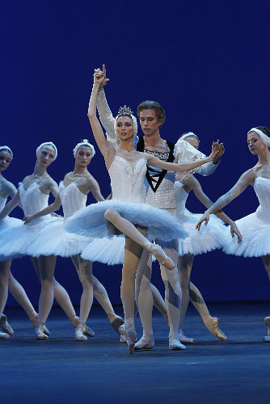
The theatre is always associated with opera and ballet. It has been the site for many notable premiers.

Slide 21
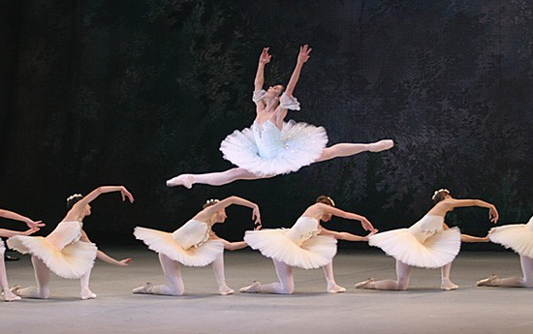
Ballet repertoire includes Tchaikovsky’s “Swan Lake”, Prokofiev’s “Romeo and Juliet”, Adam’s “Giselle” and several others.

Slide 22
